Slide 1

Presented by: Sonia Shih Xuemei Cui Cheng Chen
TAIWAN BANKRUPTCY DATA

Slide 2
Taiwan’s bankruptcy data were obtained from the Taiwan Economic Journal from 1999 to 2009. Corporate bankruptcy was defined based on the business rules of the Taiwan Stock Exchange. It contains 6819 enterprises, 94 attributes (93 features)
n = 6819, p = 93 The target with two categories: 220 positive and 6599 negative, resulted in imbalance ratio of 220/6599 = 3.33% Features are the ratios calculated from financial statements (all numerical)
Nature of the Date and Features

Slide 3
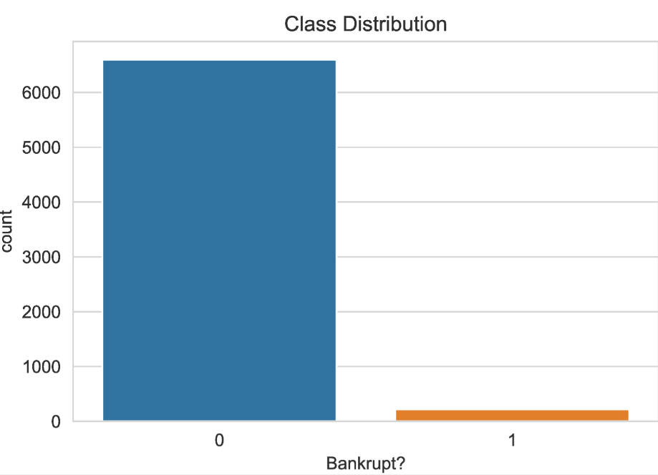
Data Exploration and Motivation
Extremely Imbalance Data
Given the extremely imbalance target, the prediction becomes difficult.
The cost of misclassification is very high as the classification serves as boundary line of distinguishing failed and non-failed companies.
A false bankruptcy prediction will mislead the company’s future operation plan as well as the decision making of other stakeholders. Therefore we want to learn which techniques is a better performer

Slide 4
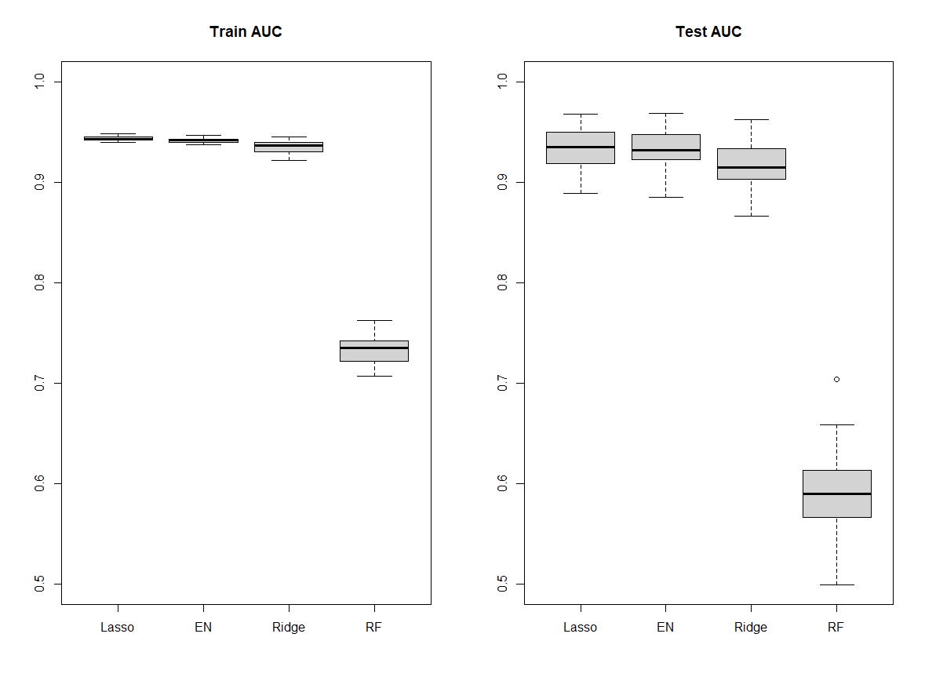
AUC Boxplots
On 50 Samples
Training
Imbalanced Data
0.9n+ & 0.9n-
Weights

Slide 5
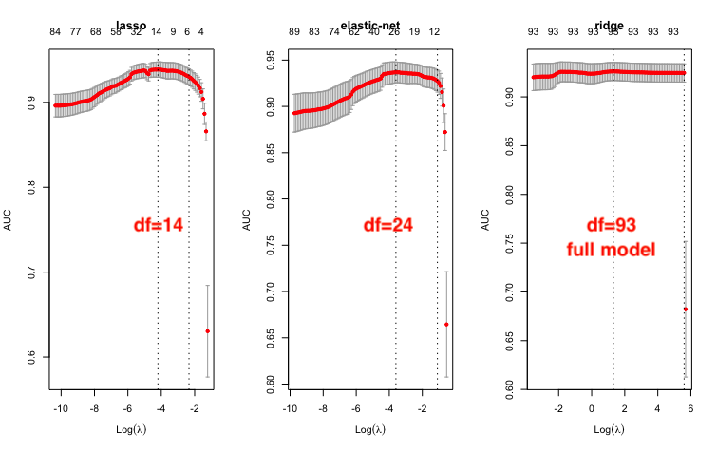
10-Fold CV Curves on One Sample & Average Running Time on 50 Samples
Lasso: 271.65 s Elastic-Net: 32.80 s Ridge: 17.34 s

Slide 6
Test AUC and Running Time - All Data
 | Median Test AUC | Time to Fit (s)
Lasso | 0.943045 | 288.25
Elastic-Net | 0.941750 | 40.11
Ridge | 0.936225 | 19.77
Random Forest | 0.734805 | 538.17
Not a clear trade-off but it is noted the random Forest is not a good option for the dataset

Slide 7
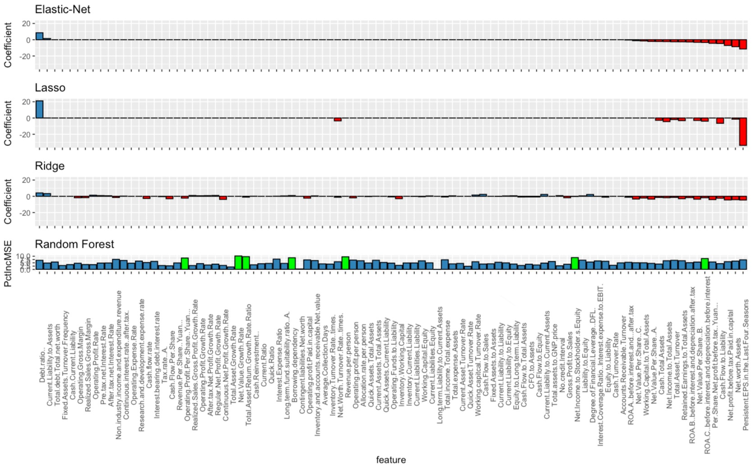
Estimated Coefficients for Each Model

Slide 8
Thank you
Conclusion
Elastic net seems to be a better performer considering the time and test score.
However, given the business context, if the time isn’t a big thing here, we might adopt lasso since it gives the highest testing AUC.

